Slide 1
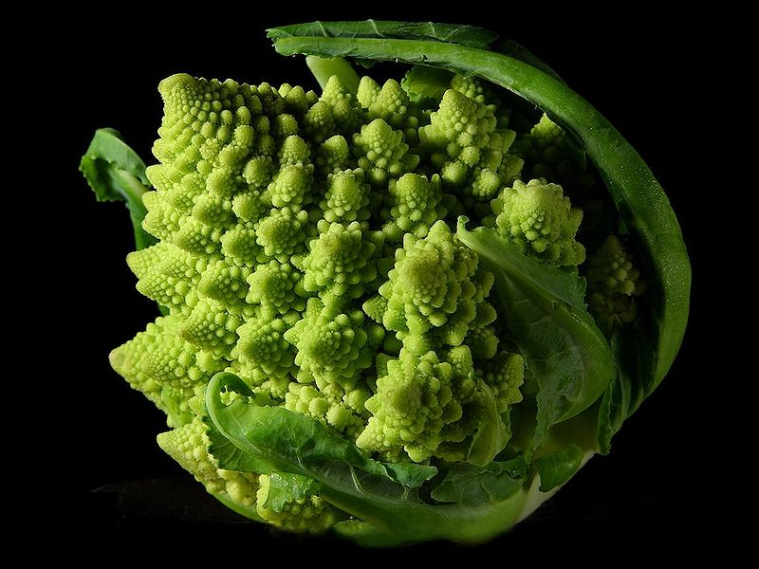
Why do fractals appear in nature?

Slide 2
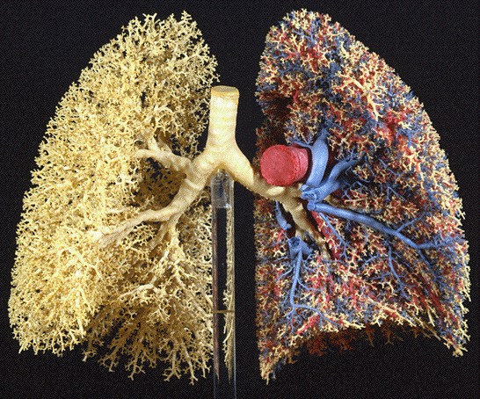
Why do fractals appear in nature?
In organisms
A simple set of rules (DNA)
Fractal structures are heritable
Need to maximize surface area but minimize volume
Efficiency of transportation
(Bailey et al. 2004)
Notes:
Kidney, circulatory system, lungs, brain
If something is made it is much harder to be fractal – though at some scale it will be because of mistakes and errors
Fractals have to grow or appear as a result of properties that are the same at multiple scales

Slide 3
Why do fractals appear in nature?
In geography
Same processes at multiple scales
Notes:
Kidney, circulatory system, lungs, brain
If something is made made is much harder to be fractal – though at some scale it will be because of mistakes and errors
Fractals have to grow or appear as a result of properties that are the same at multiple scales

Slide 4
Why do fractals appear in nature?
In geography
Same processes at multiple scales
In landscape ecology
In animal behavior
Chaos
Wait for the next lecture
Notes:
Kidney, circulatory system, lungs, brain
If something is made made is much harder to be fractal – though at some scale it will be because of mistakes and errors
Fractals have to grow or appear as a result of properties that are the same at multiple scales

Slide 5
Notes:
http://www.youtube.com/watch?v=jEmSxcr-rRc

Slide 6
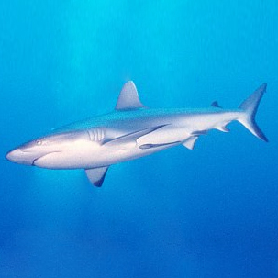
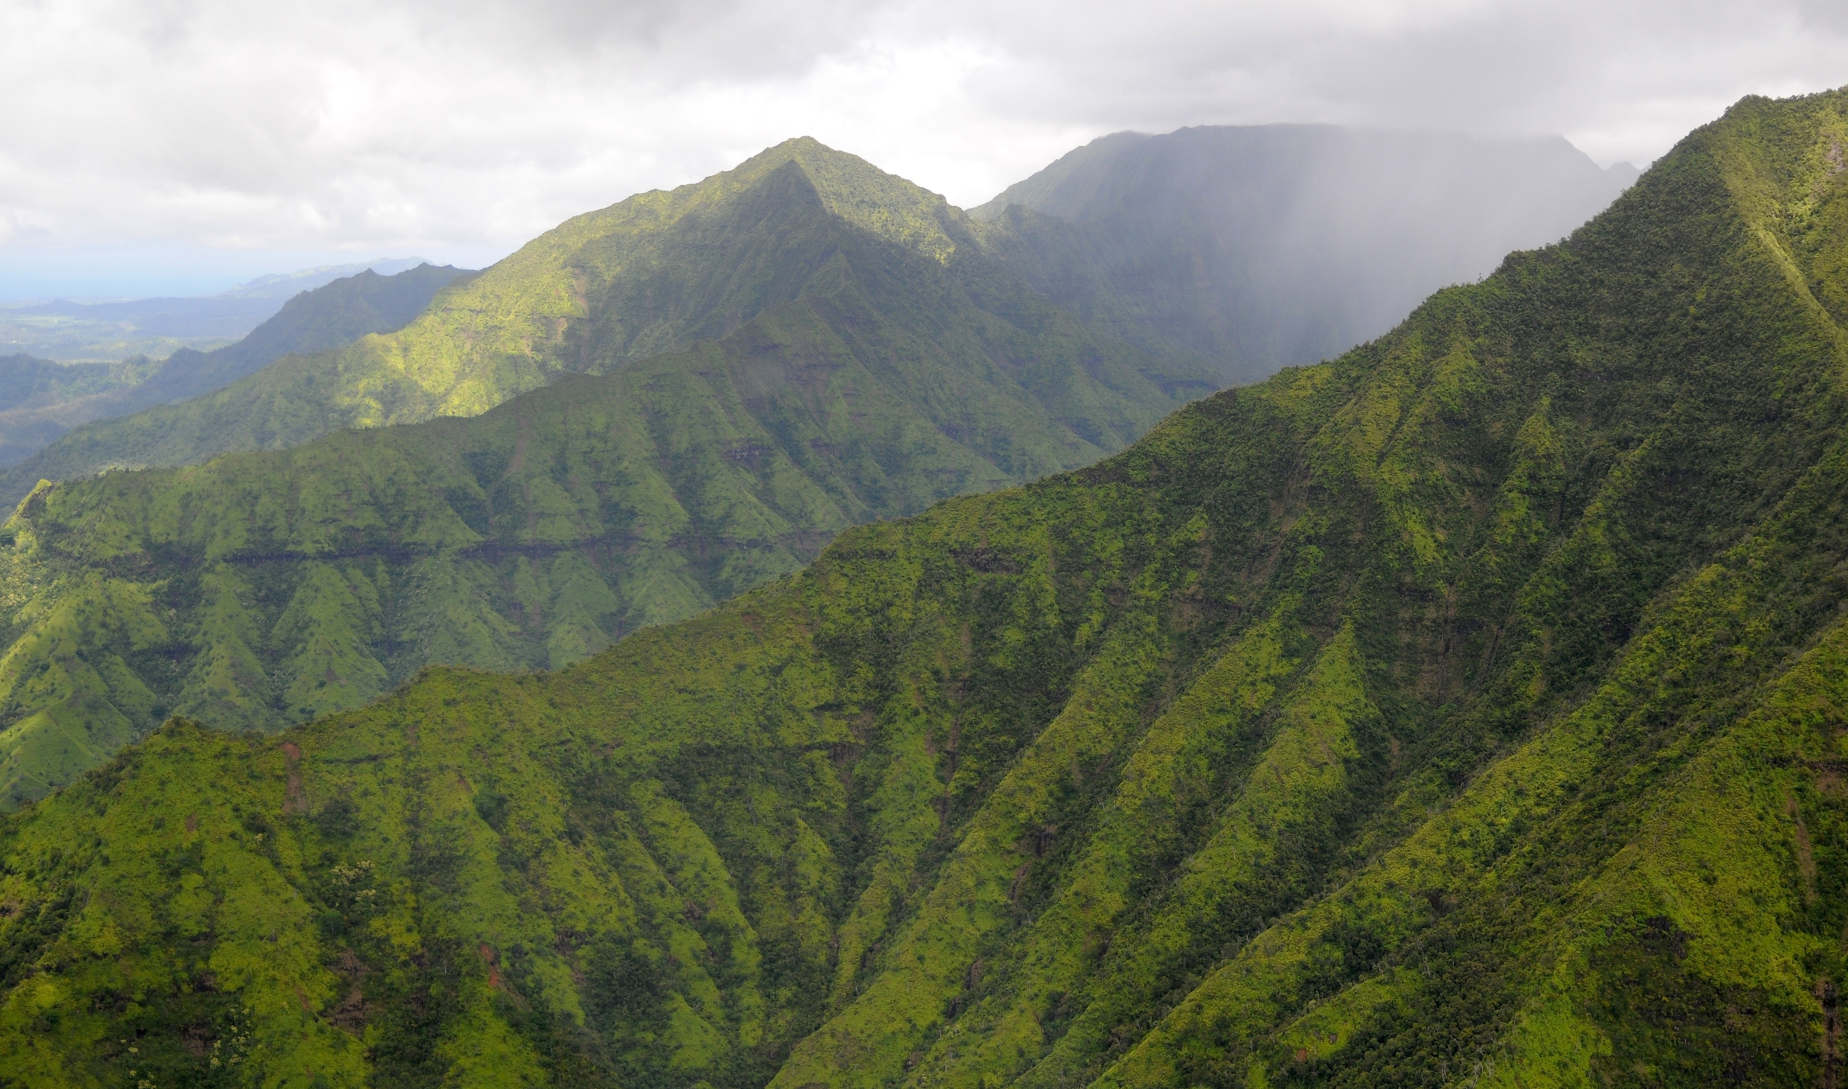
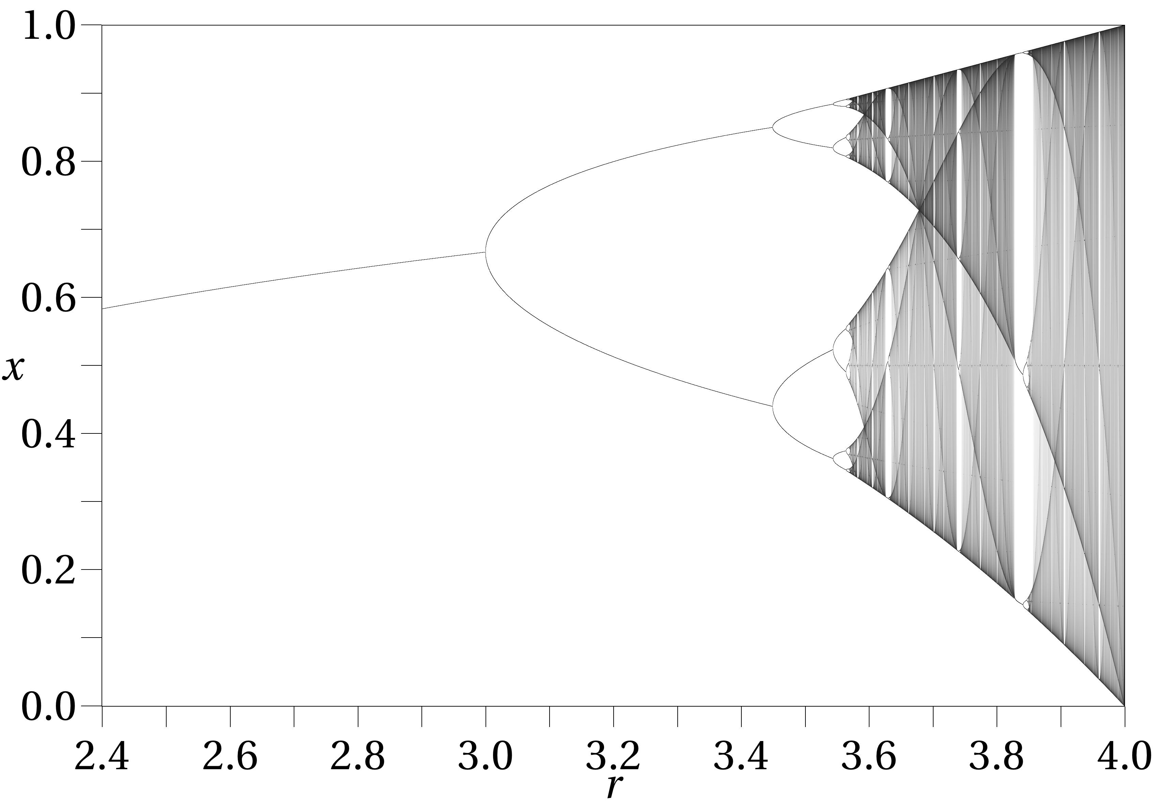


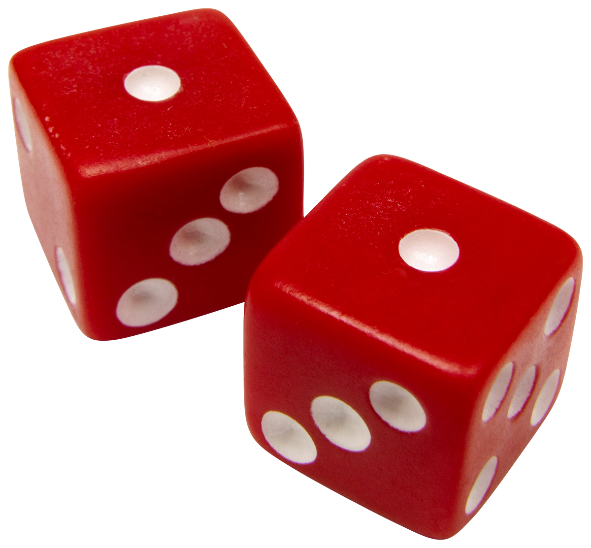

Animal behavior
Population structure
Chaos
Finance
Notes:
Fbattail - wikipedia

Slide 7
Fractals in finance

Slide 8
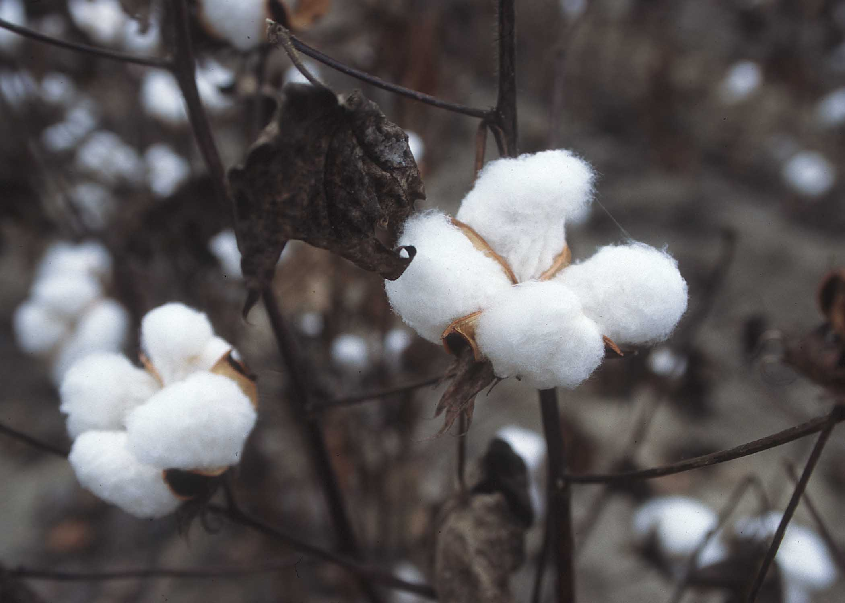
Price changes in financial markets believed normally distributed

Slide 9
Price changes in financial markets believed normally distributed
Sudden and unexpected changes: “acts of god”

Slide 10
Price changes in financial markets believed normally distributed
Sudden and unexpected changes: “acts of god”
Mandelbrot – Heavy tailed distributions much better

Slide 11
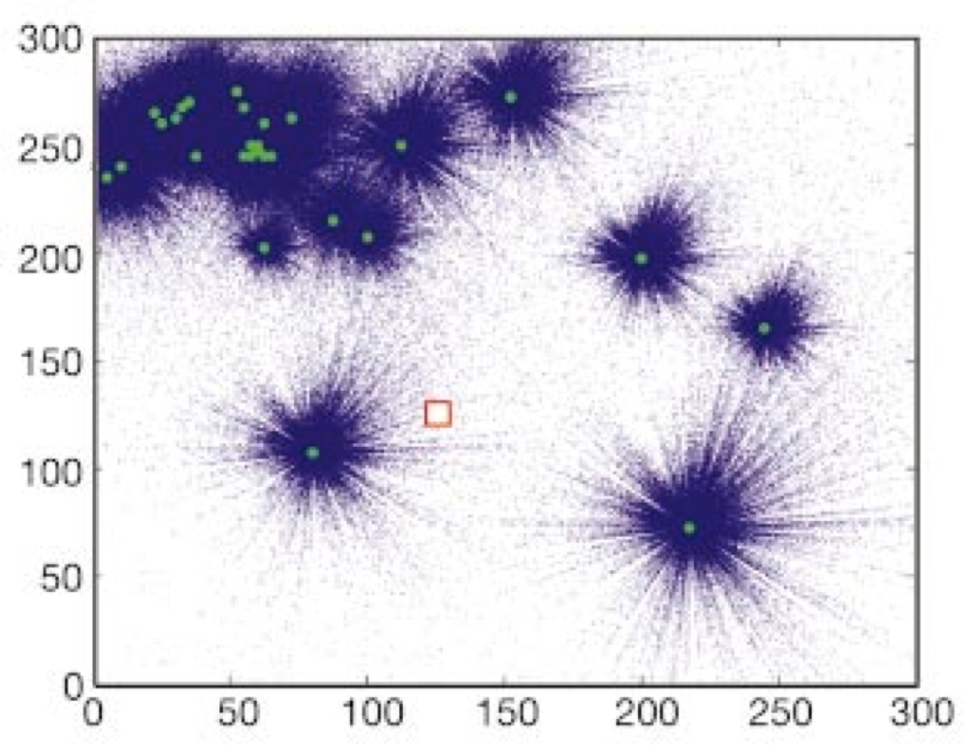
Seed dispersal
Pinus taeda
(Nathan et al. 2002)
Notes:
Nathan et al. 2002 (Nature)
Genetic methods probably needed to really know what is going is
General concensus of LDD being importat
Just as in financial markets, those rare, LDD events are still v. important

Slide 13
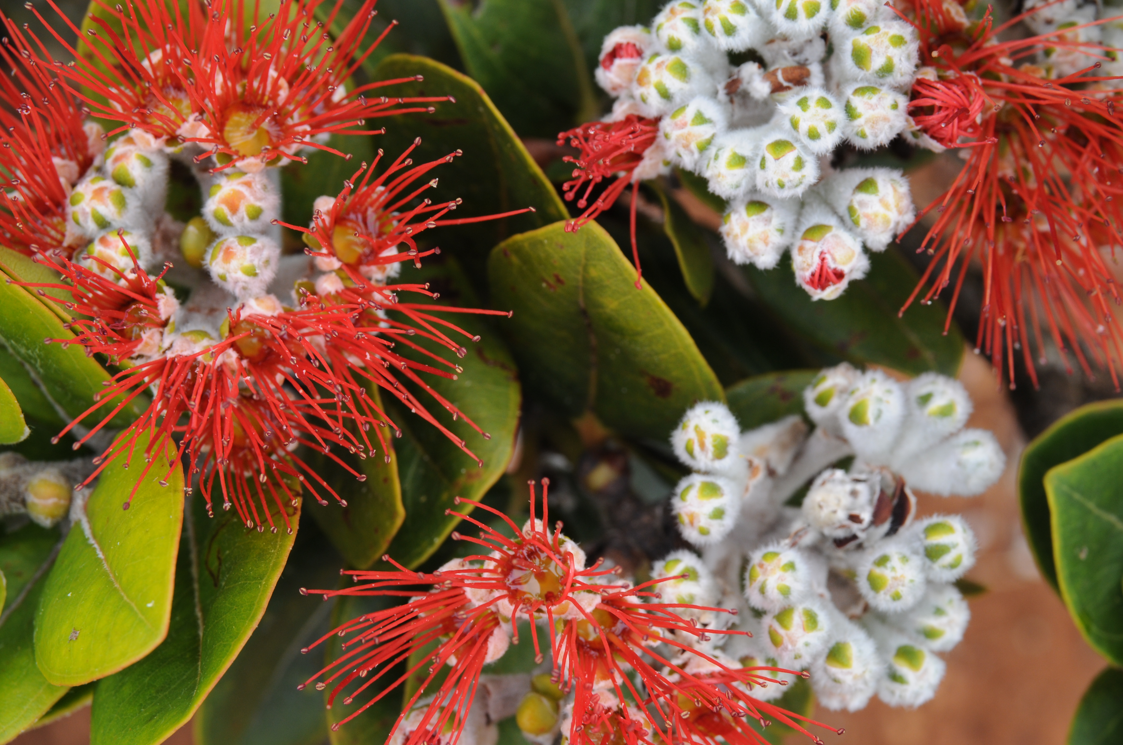

Slide 14
Gaussian and Fat tailed dispersal

Slide 15
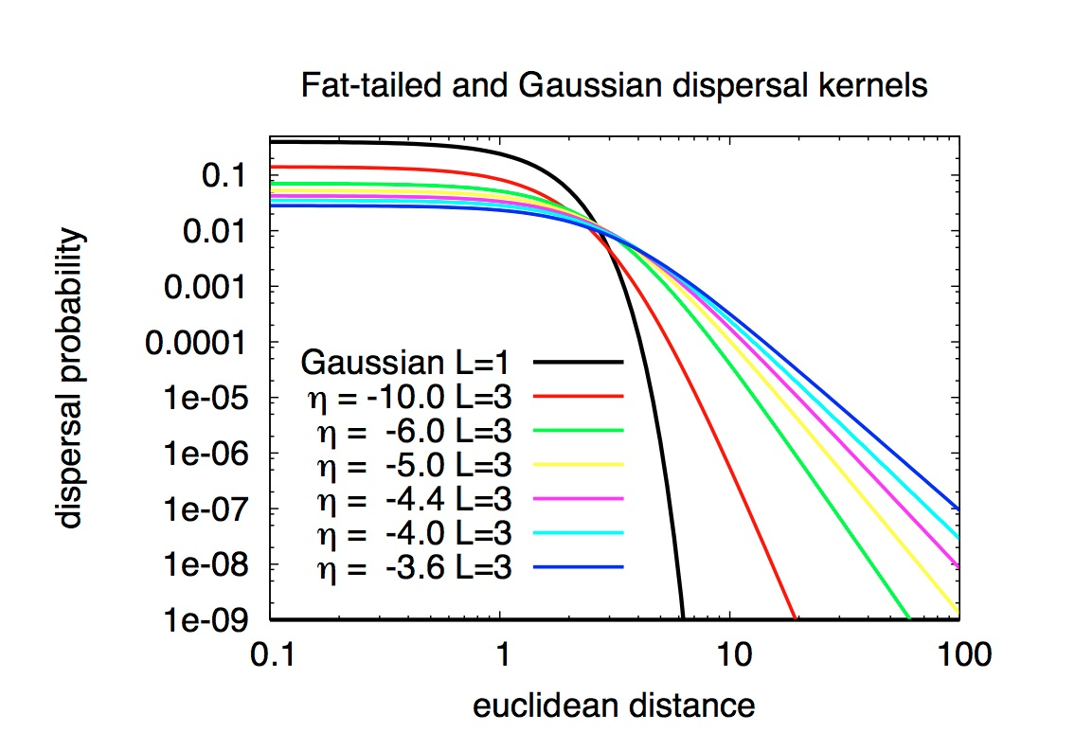
Gaussian and Fat tailed dispersal

Slide 16
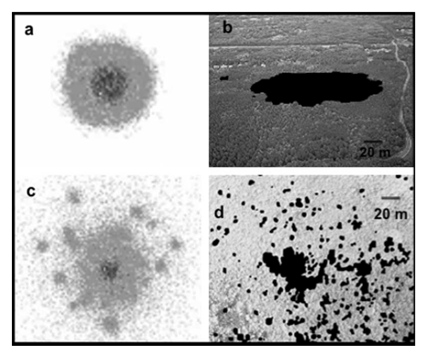
Fractal landscapes in plants
Robinia
Pseudoacacia
(clonal)
Ulmus
minor
(LDD wind)
(Marco et al. 2011)
Notes:
With SDD, fractal patterns appear only in the border of the invasion front in SDD when competitive interaction with residents is included. In contrast, LDD patterns show fractality both in the spatial arrangements of patches as well as in patch borders.

Slide 17
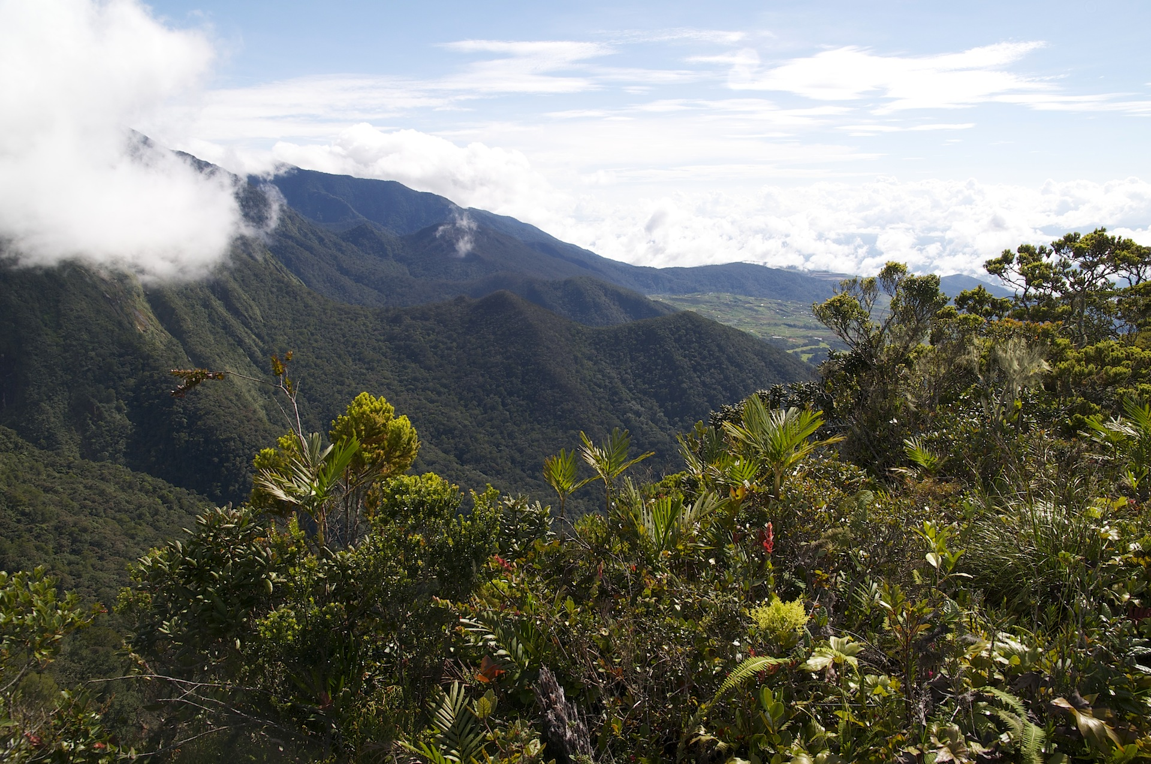

Slide 18
Log Area

Slide 19
Log num. species
Log Area

Slide 20
Species Area Relationship
Log num. species
Log Area

Slide 21
Species Area Relationship
Log num. species
Log Area

Slide 22
Species Area Relationship
The fraction of species in area A that are also found in one-half of that area is independent of A
Log num. species
If and only if
S = cA^{z}
Log Area
(Harte et al. 1999)

Slide 23
Species area relationships
Fractal patterns in species abundance
gives rise to the power law
Start with area A₀ having S₀ species
Define A_{i} = A₀2^{-i}
If found in A_{i}, probability found in A_{i+1} = a (for all i)
1
A_{0 ,} S₀
1
A_{1 ,} S_{1,1}
A_{1 ,} S_{1,2}
(Harte et al. 1999)

Slide 24
Species area relationships
Fractal patterns in species abundance
gives rise to the power law
Start with area A₀ having S₀ species
Define A_{i} = A₀2^{-i}
If found in A_{i}, probability found in A_{i+1} = a (for all i)
Let a = 2^{-z}
Expected species in A_{i} is
S_{i} = a^{i}S₀ = 2^{-iz}S₀ = (A_{i}/A₀)^{z}S₀
S_{i} = (S₀/A₀^{z}) A_{i}^{z}
which is of form S = cA^{z}
1
A_{0 ,} S₀
1
A_{1 ,} S_{1,1}
A_{1 ,} S_{1,2}
(Harte et al. 1999)

Slide 25
Non fractal behavior
Fractal behavior
Non fractal behavior
Log (total length)
Log (length of stick)
Halley et al. 2004
Notes:
Criticisms of fractals in nature – limits of scale – not perfect,
Same applies in species area relationships ….

Slide 26
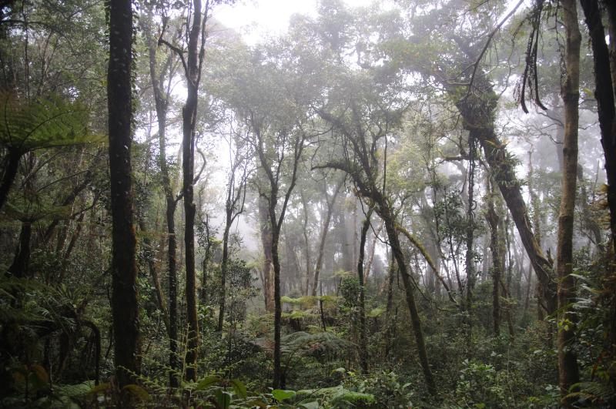
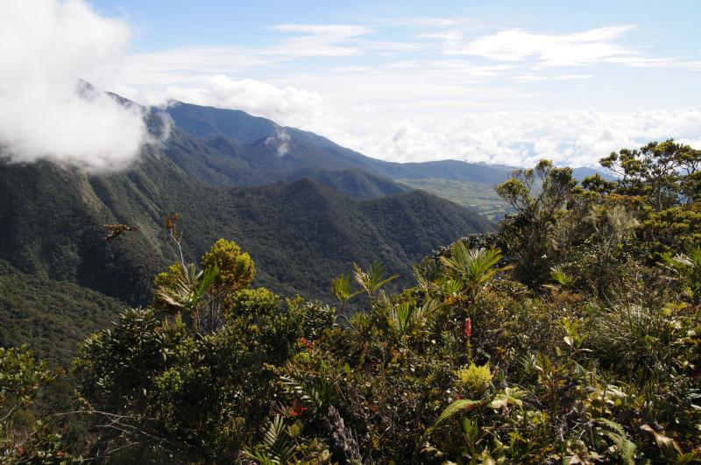
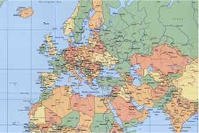
Species-area relationships
Log num. species
Log Area

Slide 27
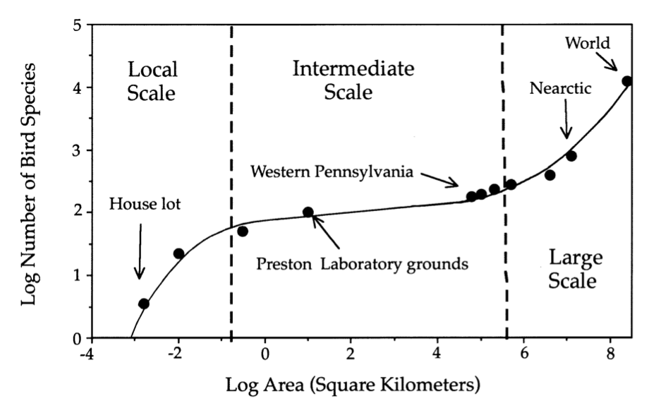
Species-area relationships
(Hubbell 2001)

Slide 28
Neutral theory : species-area relationships
Gaussian dispersal
Richness (rescaled)
Fat tailed dispersal
Area (rescaled)
(Hubbell 2001)
(Chave et. al. 2002)
(Rosindell & Cornell 2007)
(Rosindell & Cornell 2009)
(ODwyer & Green 2010)

Slide 29
Animal behavior
Optimum search strategy without local knowledge?
(Sims et al. 2008)
Notes:
Shown from data and by simulations, also the prey and resources are in a patchy distribution (fractal)
Perhaps the fat tailed dispersal kernels in plants is their way of optimum foraging

Slide 30
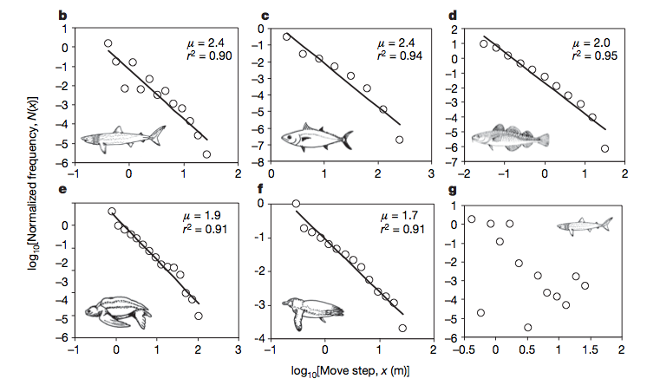
Animal behavior
Optimum search strategy without local knowledge?
Fat tailed dispersal kernels (giving rise to fractal patterns)
(Sims et al. 2008)
Notes:
Shown from data and by simulations, also the prey and resources are in a patchy distribution (fractal)
Perhaps the fat tailed dispersal kernels in plants is their way of optimum foraging

Slide 31
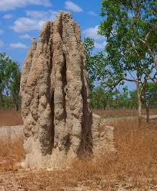
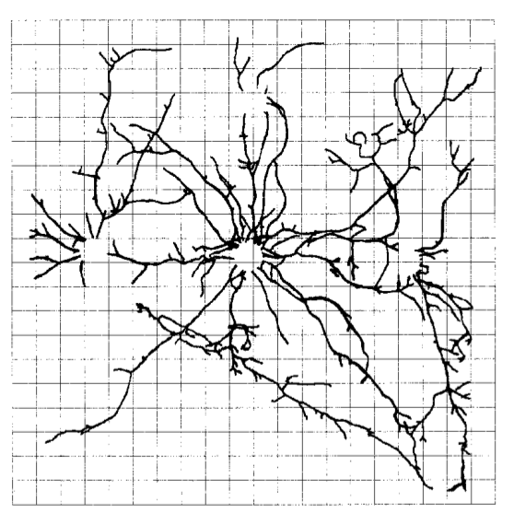
Animal behavior
Termite nests
(Sims et al. 2008)
Notes:
Shown from data and by simulations, also the prey and resources are in a patchy distribution (fractal)
Perhaps the fat tailed dispersal kernels in plants is their way of optimum foraging

Slide 32
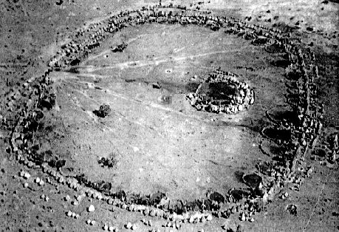
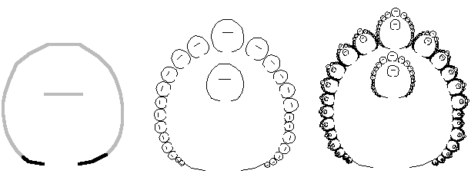
Fractal African village
Ron Eglash
TED talk
Notes:
Ron Eglash
400 metres diameter
Southern zambia
House with sacred alter and a family enclosure
Chief’s extended family in centre and chief in centre

Slide 33
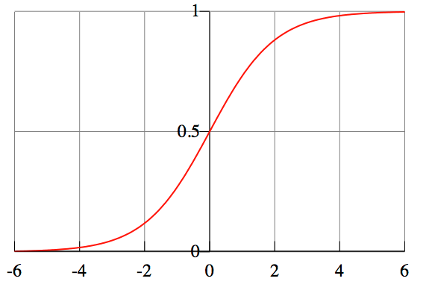
Chaos – the logistic map
Logistic function

Slide 34
Chaos – the logistic map
Logistic function
Logistic map

Slide 35
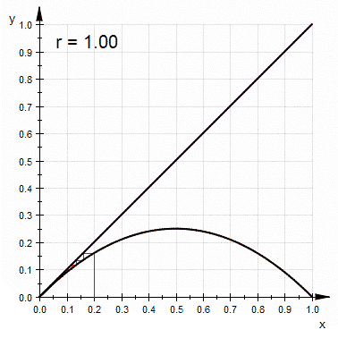
Chaos – the logistic map
(Sam Derbyshire 2010)
Notes:
http://en.wikipedia.org/wiki/File:LogisticCobwebChaos.gif

Slide 36
Chaos – the logistic map

Slide 37
Chaos – the logistic map
Notes:
Deterministic chaos (the butterfly effect)
If a (possibly chaotic) dynamical system has an attractor, then there exists a probability measure that gives the long-run proportion of time spent by the system in the various regions of the attractor.
Unpredictability is not randomness, but in some circumstances looks very much like it.
Random number generators

Slide 38
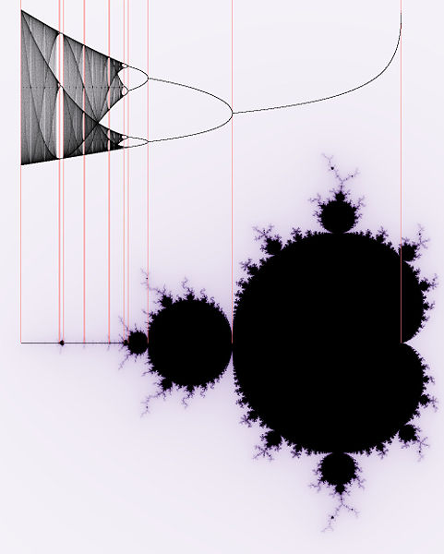
(Georg-Johann Lay)
Notes:
Images are sensitive to initial conditions
Fratal geometry describes chaos
They are two separate things but they are very closely allied to each other

Slide 39
2
1
4
5
4
3
(Georg-Johann Lay)

Slide 40
Summary
Fractals have a dimension that isn’t a whole number
Fractals display self similarity
Fractals occur in nature because of
Similar processes at different scales
Need to build complex structures from simple rules
Need to fit a large surface area into a small volume
As a result of fat tailed dispersal patterns
Fractal dimension gives us a way to measure objects (fractals) for which the normal laws of geometry do not apply
Deterministic chaos is present in systems where a small change in the initial conditions dramatically changes the outcome

Slide 41
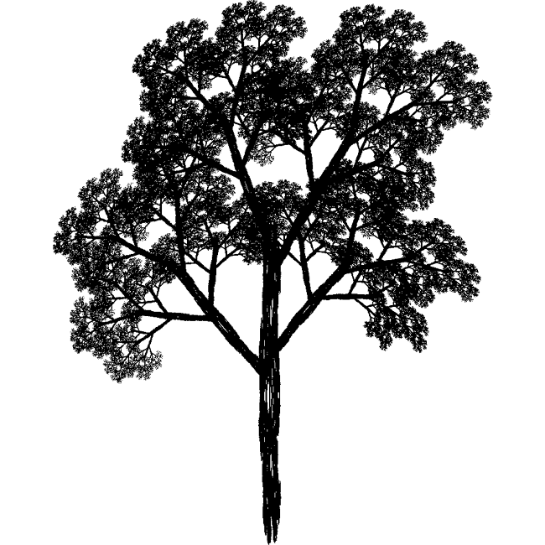

Slide 42
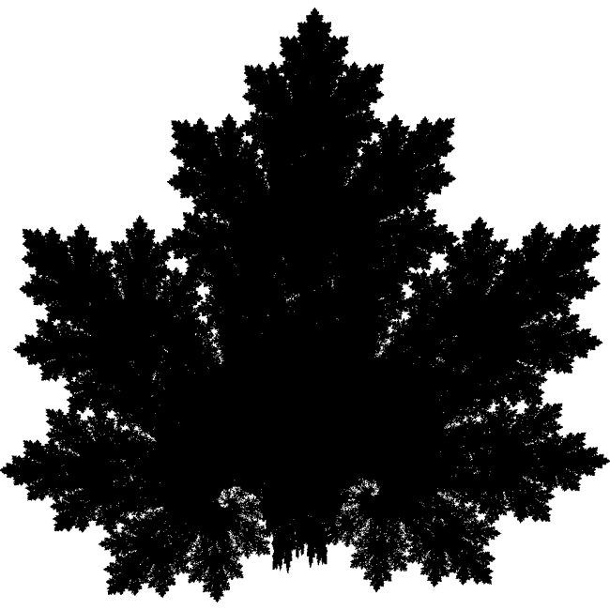

Slide 43


Slide 44
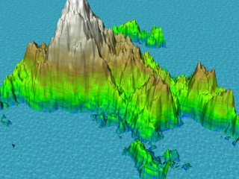

Slide 45
“Clouds are not spheres, mountains are not cones, coastlines are not circles, and bark is not smooth, nor does lightning travel in a straight line.” (Benoit Mandelbrot)
Notes:
http://math.bu.edu/DYSYS/chaos-game/node6.html cool further reading about the chaos game

Slide 46
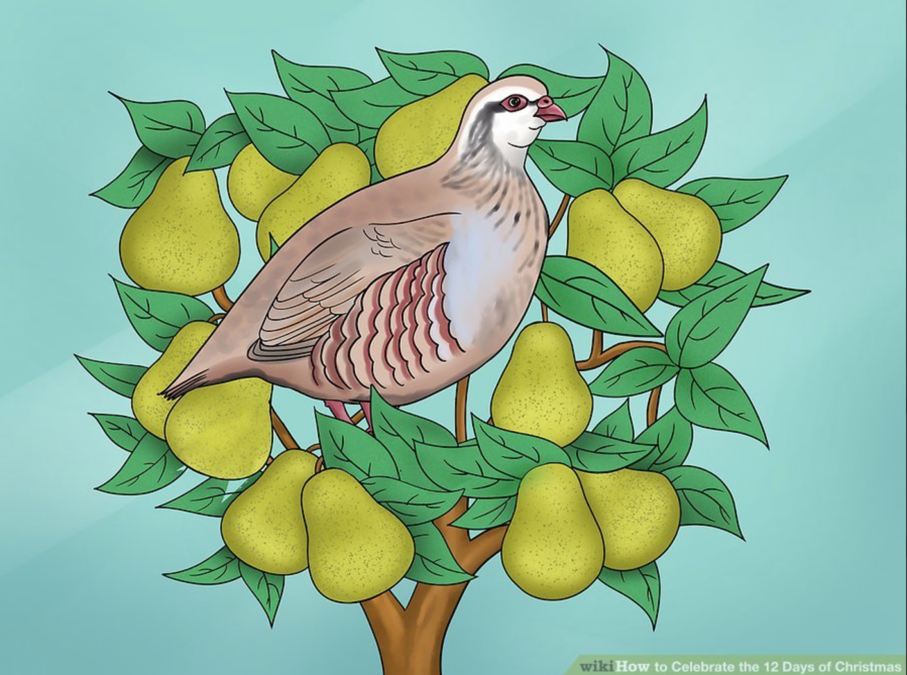
https://www.wikihow.com image uploaded by wikivisual (creative commons)

Slide 47
On the first day of Christmas, my true love sent to me
A partridge in a pear tree
https://www.wikihow.com image uploaded by wikivisual (creative commons)

Slide 48
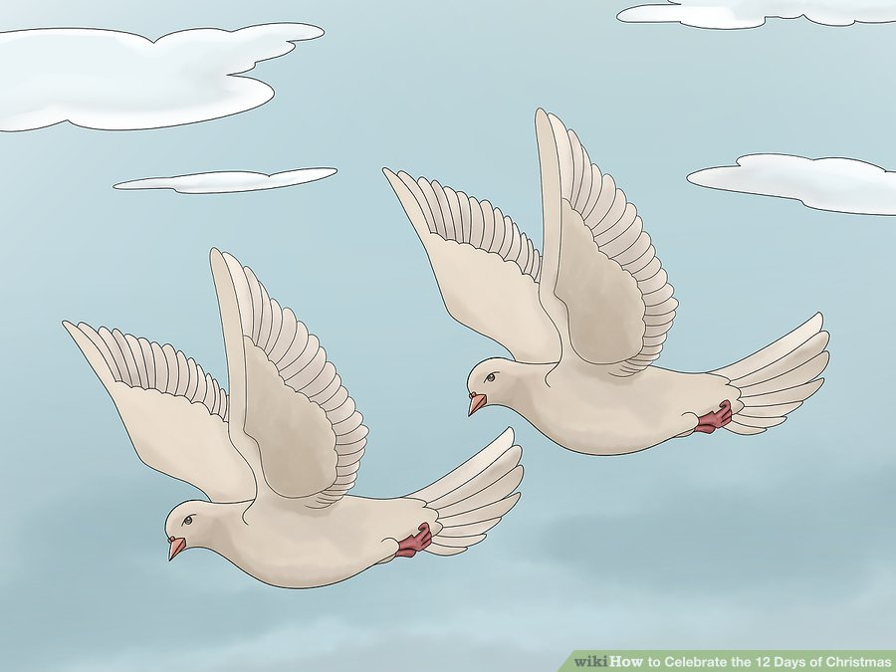
for (i in 1:12) {
print(paste("On day",i," of christmas my true love sent to me"))
for (j in i:1) {
print (paste (j," ",c("Drummers Drumming",
"Pipers Piping","Lords A-leaping","Ladies Dancing",
"Maids A-milking","Swans A-swimming",
"Geese A-laying","Golden Rings","Calling Birds",
"French Hens","Turtle Doves",
"Partridge in a pear tree")[13-j]))
}
}
https://www.wikihow.com image uploaded by wikivisual (creative commons)
Notes:
Remind to please take the SOLE survey

Slide 49
for (i in 1:12) {
print(paste("On day",i," of christmas my true love sent to me"))
for (j in i:1) {
print (paste (j," ",c("Drummers Drumming",
"Pipers Piping","Lords A-leaping","Ladies Dancing",
"Maids A-milking","Swans A-swimming",
"Geese A-laying","Golden Rings","Calling Birds",
"French Hens","Turtle Doves",
"Partridge in a pear tree")[13-j]))
}
}
https://www.wikihow.com image uploaded by wikivisual (creative commons)
Notes:
Remind to please take the SOLE survey

